Slide 1
Transportation for Illinois Coalition
State of Illinois’ Transportation Infrastructure and State Funding Challenges
Notes:
(Introduce yourself and your personal organization)
The Transportation for Illinois Coalition is a coalition of business, labor, and economic development groups with a shared interest in transportation infrastructure. TFIC brings together upstate and downstate interests across all modes to speak with a unifying voice for the transportation interests of Illinois.

Slide 2
We are going to show you how Illinois can
Improve roads, bridges, transit, rail, air, and possibly waterways
Prevent 4 in 10 miles from becoming unacceptable and improve existing conditions so that 9 in 10 miles are acceptable.
Allow transit systems to buy new buses, trains, and other capital improvements
Ensure Illinois goods get to market and continue to be cost competitive through local roads investment and funding for possible improvements to rail, air, and waterways
Restore the public trust in transportation spending
All for less than $11 a month

Slide 3
Transportation is key to the Illinois economy.
The Illinois Economy is Tied to Transportation
Throughout its history, Illinois’ people and political leaders have remained committed to building and maintaining world-class infrastructure. They had the foresight to realize Illinois’ development depended on transportation
The Illinois & Michigan Canal linked Chicago to the Mississippi River, making Chicago the key crossroads for shipping goods in 1836—just 18 years after Illinois became a state.
Illinois quickly built railroads to become the linchpin in connecting the eastern and western United States by rail.
Paved roads were built when the automobile became the primary mode of transportation and airports in the dawn of the aviation era.
With each improvement in transportation, Illinois’ leaders realized the State must improve its infrastructure or lose its competitive edge.

Slide 4
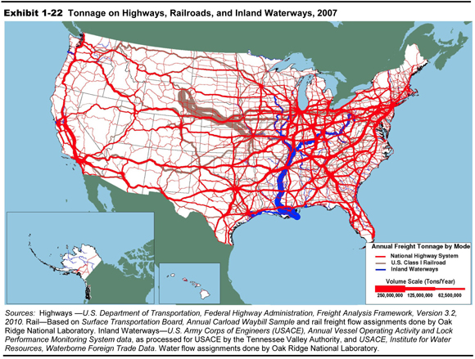
Freight movement radiates to and from Chicago, connecting Illinois to the rest of the United States and the world.
Map from FHWA

Slide 5
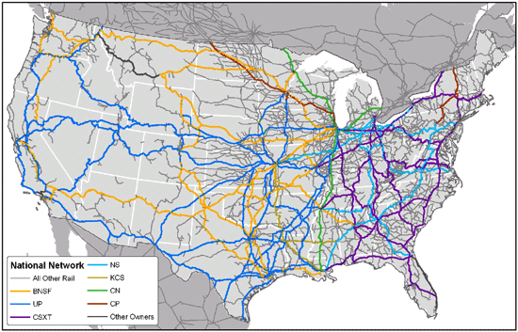
Illinois is a Hub for the US Freight Rail Network
Map from National Surface Transportation Policy and Revenue Study Commission

Slide 6
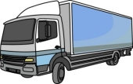

Transportation is key to the Illinois economy.
Illinois has a vast transportation system designed to meet economic demand
Illinois has the nation’s third largest inventory of public roads and bridges
146,715 miles of public roads
25,906 bridges
Over 103 billion vehicle miles travelled a year
  Illinois has the third largest transit system in the country
  Over 7,200 route miles
  Nearly 2 million rides per day in Chicago area and 41.8 million people served by downstate transit
  Over $42 billion in assets
Illinois has the 2nd largest rail network in the country
  Chicago is the single largest rail hub in the nation
  Over 37,500 cars and 700 passenger trains daily
  ¼ of all rail-shipped goods pass through Chicago
Also blessed with the 8th most navigable waterways in the nation to move heavy, large cargo and 3rd busiest airport for cargo and passenger flight
Notes:
With nearly 147,000 miles of public roads and nearly 26,000 bridges, Illinois has the nation’s third largest inventory. Within the state over 103 BILLION vehicle miles are travelled a year.
In addition, Illinois has the third largest transit system in the country comprising over 7,200 route miles and providing nearly 2 million rides per day.
Illinois’ rail network is the second largest in the country. Chicago is the single largest rail hub in the nation with over 37,500 cars and 700 passenger trains daily. Over ¼ of all rail-shipped goods pass through Chicago.

Slide 7
Transportation is key to the Illinois economy.
Governor Quinn Announces Innovative Swedish-Based Manufacturer to Expand in Naperville
eNews Park Forest
Michelin’s New Distribution Center in Wilmington to Open in 2015 and Employ Hundreds
The Bugle
New Hangar at Rockford International Airport will Bring 500 Jobs
WREX 13
Good transportation infrastructure is good for the economy and jobs. Businesses choose to locate in Illinois because of location and transportation network.

Slide 8
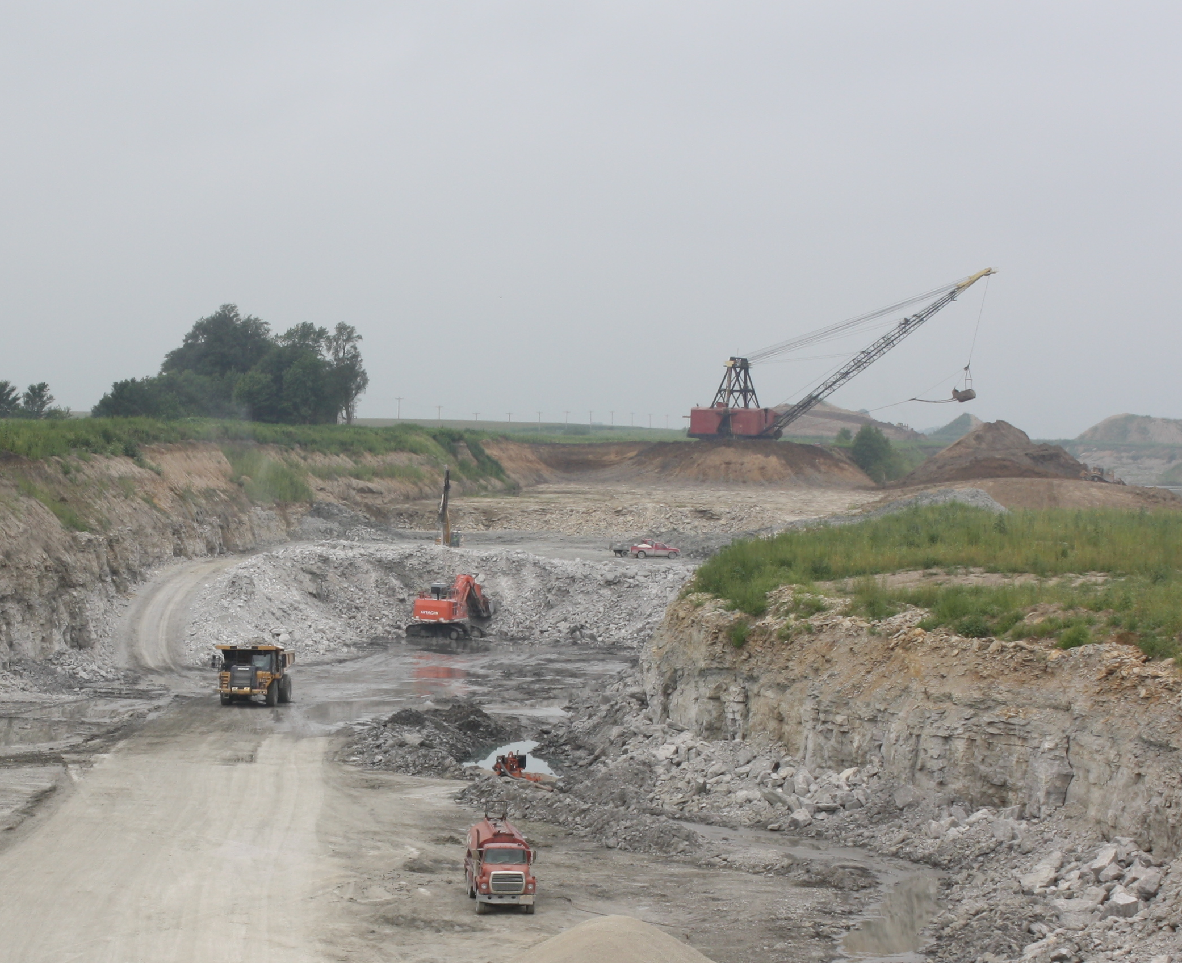
Transportation is key to the Illinois economy.
Building good infrastructure also creates jobs. The TFIC plan is estimated to create about 36,000 ongoing new jobs.
Work Zone Ahead

Slide 9
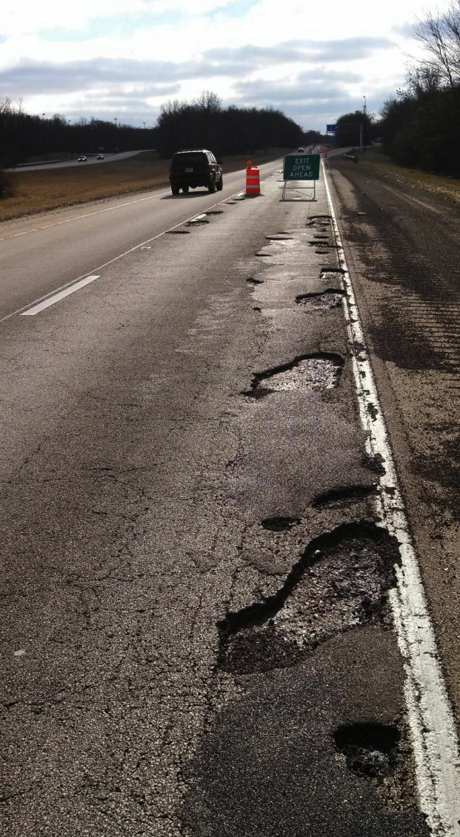
We are falling behind on investment in transportation infrastructure.
Public Highway System
The current highway condition is 82% acceptable.
The current state bridge condition is 93% acceptable.
Without new funding (and assuming flat federal funding) by 2020 these numbers will be:
  Highways: 61% acceptable.
  Bridges: 87 % acceptable
Notes:
What is the condition of our public highway system?
Acceptable is a function of 1) the condition of the highway as evaluated by IDOT using a Condition Rating Survey (CRS); 2) type of highway (interstate, freeway, unmarked state route, etc.); and 3) average daily traffic. [CRS is a function that provides a value from 1 to 9 with 9 being the best. Inputs into the CRS include International Roughness Index as well as other distresses based on the surface type (concrete or asphalt). CRS has been used for decades by IDOT to rate state highways.]
There are several reasons for the rapid decline.
The system is “worn out”. Many highways have exceeded their design life with most Interstates built over 50 years ago.
With the exhaustion of Illinois Jobs Now! bonds, the state’s resources have been consumed.
Declining revenues and increased operational costs have create a highly inadequate Pay-As-You Go maintenance program
And finally increased costs due to inflationary factors have weakened buying power.

Slide 10
We are falling behind on investment in transportation infrastructure.
Rapid decline in highway and bridge condition is caused by:
  Exceeding highway design life (Interstates over 50 years old)
  Illinois Jobs Now! expiring
  Maintenance program underfunded
  Increased costs due to inflation
  No fuel tax increase for 24 years

Slide 11
We are falling behind on investment in transportation infrastructure.
MYP Annual Funding and Backlog Miles
MYP: 300 programmed miles annually
To prevent growth in the backlog: 800-1000 programmed miles annually.

Slide 12
We are falling behind on investment in transportation infrastructure.

Slide 13
We are falling behind on investment in transportation infrastructure.
Public Transit System
The Chicago public transit systems rely on aged infrastructure.
2nd oldest public transit inventory in the country
42% of passenger cars are beyond their useful life
Growing demands for expansion
Downstate transit systems are numerous and diverse with growing needs for expansion. No ongoing capital funding currently.

Slide 14
We are falling behind on investment in transportation infrastructure.
Public Transit System
State-of-Good-Repair (SGR) backlog for the region is $19.5 billion or 54% of total needs.
10-Year capital need for normal capital reinvestment is $16.6 billion or $1.66 billion annually
Current capital reinvestment is $563-$765 million annually
Notes:
As of December 2013, the region’s total capital reinvestment needs over 10 years are estimated to be roughly $36.1 billion (Figure 1-1). This includes $19.5 billion to address the existing investment backlog (54 percent of total needs) and an additional $16.6 billion to address normal reinvestment needs expected over the next ten years (2014 to 2023), or $1.6 billion per year. Normal reinvestment includes normal asset replacement, rehabilitation, and expenditures on minor capital repairs grouped under “annual capital maintenance” (ACM).
A a significant proportion of the region’s reinvestment needs (the backlog in particular) are associated with the region’s older rail assets and insufficient capital reinvestment over time

Slide 15
We are falling behind on investment in transportation infrastructure.
Public Transit System
Notes:
The range for the region’s current combined rate of capital reinvestment is estimated between $563 million and $765 million annually. This is considerably less than $1.6 billion annual amount required to address expected normal reinvestment needs over the next ten years. This outcome implies continued growth in the region’s deferred investment backlog, as illustrated in this figure, and potentially increasing proportions of assets in not state of good repair.

Slide 16
We are falling behind on investment in transportation infrastructure.
Public Transit System
Notes:
Expected annual RTA region capital funding is currently estimated to range from $0.56 to $0.77 billion per year. This figure presents the level of investment required to attain specific investment targets and the gap between the required and expected funding (both low and high funding estimates are shown in the graphic with the dotted lines). For example, an estimated $2.62 billion in annual reinvestment is required to attain SGR in twenty years (including full elimination of the backlog). To maintain the current size of the region’s investment backlog requires an estimated $1.45 billion in annual expenditures

Slide 17
We are falling behind on investment in transportation infrastructure.
Status of Federal Funding
  Federal Highway Trust Fund monies not keeping up with inflation (they represent about 75% of Illinois’ road funding)
  A 23-46% increase needed to improve conditions and performance (USDOT)
  As a result of MAP-21’s shorter time frame, state DOTs, businesses, and labor unions have been unable to plan projects, purchases, and training programs.
  Need immediate increase in revenues – probably gas tax – and a long-term sustainable funding solution
“I think we ought to be rewarding states that are doing that and get those projects moving quicker.” – Congressman Shuster on Arkansas Increasing the State Funding Portion of Projects
Notes:
As mentioned previously, in order for the state to not fall below the 61% favorability on roads and 87% favorability on bridges , the federal government needs to maintain their currently level of support.
But as many know the federal highway trust fund is broke.
As at the state level, the revenues are declining and inflation is causing buying power to constantly decline.
US DOT estimates a 23-46% increase is needed in order to show improvement in conditions and performance.
So as we struggle at the state level for long term, sustainable resources – so will the federal government.

Slide 18
Advantages of Taking Action at the State Level to Fund Transportation
Continue to match federal funds.
Ensure local roads get needed funds
Better control of our destiny as a state
Have measurable results
  Condition rating system, bridge survey
  90/93% acceptable
  Auditor General oversight
Pay slightly more in taxes and fees to prevent bigger losses in car repairs, lost time, cost of goods, etc.

Slide 19
Advantages of Taking Action at the State Level to Fund Transportation
Improve Local Roads
Illinois is the second largest producer of corn and the third largest producer of soybeans. Getting these products to market depends on the local road system.
We all drive on local roads every day
Yet, local roads are operating on smaller budget with rising costs.
State of Illinois – MFT Revenue/Costs vs. Purchase Power
Counties [% Increase over State FY 2000]

Slide 20
Advantages of Taking Action at the State Level to Fund Transportation
Measurable Results
Restore public trust
Make necessary improvements to avoid collapse of transportation system and lay foundation for a transportation network of the future

Slide 21
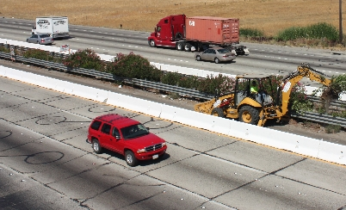
Are we supporting the infrastructure that supports us?
Why We Should Invest a Little More Now
Understandably, we are all concerned about paying more to support roads and bridges. However, the result of failing to pay more will cost us more.
California had a Pavement Condition Index (PCI) rating of 66 in 2011
The poor condition of California’s infrastructure costs California drivers an average of $703 annually (TRIP). The cost in many areas is much higher.
Illinois is projected to deteriorate to 61% acceptable under a similar rating system.
That would be about a 50% increase
in costs to Illinois drivers.
(About $250 a year)
Portion of I 580 from Pleasanton Weekly

Slide 22
Are we supporting the infrastructure that supports us?
Currently the average motorist pays $372 a year in state and federal taxes and fees to support Illinois’ roads and bridges
  About $31 per month today
TFIC plan: Less than $11 a month
$449 per year per driver: extra vehicle repairs/operating costs from driving on roads in need of repair cost Illinois drivers. (TRIP)
$37 per month
Increased repair backlog will cost more.
Notes:
Other costs related to poor investment in infrastructure, according to The Road Information Project are
$723 per year per Illinois resident: medical costs, lost productivity, travel delays, workplace costs, insurance costs, and legal costs from motor vehicle crashes.
American motorists lose $121 billion per year in wasted time and fuel costs from congestion.

Slide 23
TFIC Proposal for Discussion
Notes:
In order to properly build a transportation program we must first calculate what it costs to fix the system.

Slide 24
TFIC Proposal for Discussion
Reforming the way we fund transportation
Eliminate diversions
Show, demand measurable results
Meet agreed upon improvement measures

Slide 25
TFIC Proposal for Discussion

Slide 26
TFIC Proposal for Discussion
Transportation Funding Goals:
  Restore the state highway system to 90% acceptability for roads and 93% acceptability of bridges
  Provide an adequate PAYG program that will maintain those favorability ratings into the future
  Provide reasonable increase in funding for local roads --over 88% of road miles (60% State-40% Local Roads split of increased revenues)
  Provide for a PAYG funding component for transit to meet their deteriorating infrastructure needs
  Provide for other transportation needs through an adequate bonding component
Notes:
An adequate capital program should address the following goals:
Restore the state highway system to an acceptability of 90% for roads and 93% for bridges
Acceptable is a function of 1) the condition the highway as evaluated by IDOT using a Condition Rating Survey (CRS); 2) type of highway (interstate, freeway, unmarked state route, etc.); and 3) average daily traffic.
[CRS is a function that provides a value from 1 to 9 with 9 being the best. CRS has been used for decades by IDOT to rate state highways.]
Provide a large enough annual maintenance program to maintain those percentages into the future
Provide a reasonable increase for the 88% of road miles that fall under a local jurisdiction – typically a 60/40 split between state and local roads
Provide a sustainable and reliable Pay-As-You-Go funding component for transit systems to meet their deteriorating infrastructure needs a
And finally provide an adequate bonding component in order that will to meet other transportation pressures such as CREATE, high-speed rail and new starts

Slide 27
TFIC Proposal for Discussion
The TFIC Plan
Pay-As-You-Go (in thousands annually)
Amount needed to maintain state system
$667,000.0
Amount needed for local roads to maintain
60% state/40% local split
$445,000.0
Amount needed for transit to maintain
80% roads, bridges/20% transit split
$278,000.0
Total PAYG amount
$1,390,000.0
Notes:
TFIC would advocate an adequate amount of money be generated to maintain the state highway system and not allow it to deteriorate to the predicted levels. To accomplish that goal we estimate that an additional $667 million per year would need to be generated.
Next, in order to meet the 60/40 split between state and local roads an additional $445 million per year would be necessary
Finally, in order to provide an 80/20 split between roads and transit an additional $278 million per year would be necessary.
All together, TFIC estimates an additional $1.39 billion in annual PAYG funding in needed.

Slide 28
TFIC Proposal for Discussion
The TFIC Plan
Bonding over 6 Years (in thousands)
To achieve acceptability of 90% roads/93% bridges on the state system
$1,000,000.0
Proportional amount for local roads (60% state/40% local split)
$667,000.0
Proportional amount for transit (80% roads, bridges/
20% transit split)
$417,000.0
To meet extra pressures, ie. CREATE, high-speed rail, new starts, etc..
$3,000,000.0
$5,084,000.0
Total Bonded amount
Amount needed annually for debt service
$450,000.0
Notes:
As for the bonded component, in order to bring the current state highway system to the 90/93% IRI favorability rating, an additional $1 billion in bonding is needed.
To maintain the 60/40 split with local roads and 80/20 split with transit, an additional $1.084 billion is necessary.
TFIC would also advocate the need of an additional $3 billion in order to meet other transportation pressures.
All together, this would result in over $5 billion in bonding which would require an additional $450 million per year to pay the debt service on those bonds.

Slide 29
TFIC Proposal for Discussion
The TFIC Plan
The Need (in thousands)
Annual PAYG
$1,390,000.0
Annual Debt Service
$450,000.0
Total new annual revenues needed
$1,840,000.0
Notes:
TFIC estimates the total amount needed in additional , annual resources is $1.84 billion.

Slide 30
TFIC Proposal for Discussion
The TFIC Plan
Revenues – Overall Principles
Sustainable revenues that will keep up with inflation
Significant amount to be directed to PAYG maintenance
Auditor General Oversight (audit every two years)
End diversions – user fees should be directed toward the system
  $53 million from user fees currently deposited into General Revenue Fund
  $69 million in road dollars spent on non-road purposes
Notes:
Where does the state find that kind of resource to meet its transportation needs?
As the legislature debates revenue options, TFIC would advocate they adhere to three overall principles.
First, unlike the declining sources of revenue which fund transportation today, revenues should be sustainable and keep up with the cost of inflation.
Second, those who use the system should pay for the system but that goes both ways. Any current revenues that are generated by users should be redirected into the transportation system.
And finally, we need to resist the urge to direct all the funding into debt service on bonds. Although this provides a large amount of one-time resource, once it is gone there is nothing left to maintain the system going forward.

Slide 31
TFIC Proposal for Discussion
The TFIC Plan
Revenues
Ending diversions: $125M to $1B
Broad-based, low-rate: $150M to $1B
User Fees: $100M to $1.5B
Notes:
TFIC would present for consideration the following options that meet our core principles. This is not meant to be an exhaustive list of potential revenues but rather a list of choices. Note that not all members of TFIC agree with all of these options but all members agree that the problem must be addressed and the solution will not be an easy one.
The first option would be to end all current diversions which could generate over $900 million annually. The largest diversion is the sales tax on fuel paid at the pump by motorists. It should be noted that these taxes are currently deposited into the General Revenue Fund. This will create further stress on an already inadequate state budget.
Another option would be institute some revenue trade-offs. Currently there is a sales tax credit associated with the sale of ethanol. The credit has run its course and most advocate that it should end. We would suggest ending the credit and capturing those revenues for transportation. Also, commercial truck drivers pay a Commercial Distribution Fee that is deposited in to the General Revenue Fund. TFIC would suggest ending the fee and increasing the diesel differential by a like amount. This will drive the money to transportation purposes and allow the trucking industry to better absorb the cost.
Finally, there are certain taxes and fees that could be increased. TFIC would offer for suggestion a slight increase in motor fuel tax – the current tax has not been raised since 1980, increased revenue from registrations and potentially taxing certain auto related services which are currently not taxed.

Slide 32
INSERT LOCAL FUNDING NUMBERS WHERE APPROPRIATE

